Slide 1
Best Practices
Program Goals - Discuss
What are Best Practices?
What makes them useful?
What tools are there?
What role does Administration have with Best Practices?
What Local and Cooperative Strategies Work?
Cyril Oberlander, SUNY Geneseo
Notes:
Anyone want to take a stab at the definition? And it’s no fair to say the opposite of worst practices. (Pause)
I appreciate your time in discussing these goals?

Slide 2
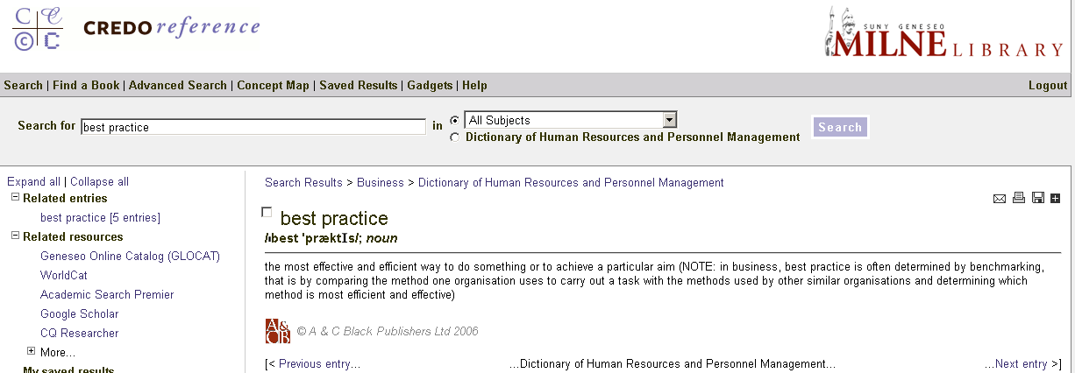
Best Practices
Best practice
the most effective and efficient way to do something or to achieve a particular aim.
(NOTE: in business, best practice is often determined by benchmarking…) Dictionary of Human Resources & Personnel Management
Notes:
Everyone comfortable with this definition of best practices – anyone want to add anything?
Does the definition of Best Practice have any similarities to the IDS Project?
CLICK
2. Although not stated, the IDS Project goals appear to parallel the meaning or objectives of best practices. That said, what may be most challenging with best practices, is making them practical, identifiable, acceptable, and shared. Do we identify quirky and irritating things about our workflow? In terms of benefits of looking for best practices… - CLICK

Slide 3
Best Practices – Benefits
What makes best practices useful?
Improve service qualities:
Decrease turnaround time
Increase accuracy / reduce errors
Enhance service offerings; color, delivery, customer satisfaction, etc.
Reduce cost
Reduce staff time
Others?
Notes:
What makes best practices useful to libraries? Pause – or CLICK (Any that aren’t up there?)
So if we agree on the definition and we agree generally on the usefulness of best practices, then…

Slide 4
Best Practices
How do you know what is a best practice?
&
What criteria do you use?
So are there helpful tools?
Notes:
How do you know what is or isn’t a best practice? Is there an easy answer here, say what is a worst practice?
What makes best practice recognition a tough job? (PAUSE) I suspect it must be that it requires us to evaluate the many options out in practice, and agreeing on a metric. With ILL workflow, one metric I use is does it save time – which goes back to the benefits.
Anyone want to share an example of a local best practice? And explain the criteria or metric used?
Discussion
CLICK – So are there helpful tools? Pause?/Discussion?

Slide 5
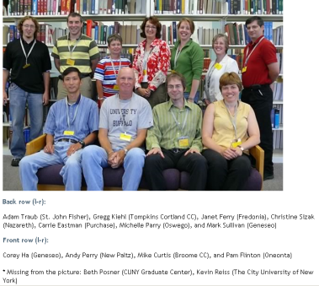
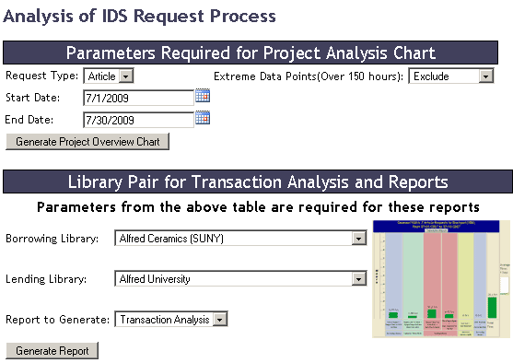
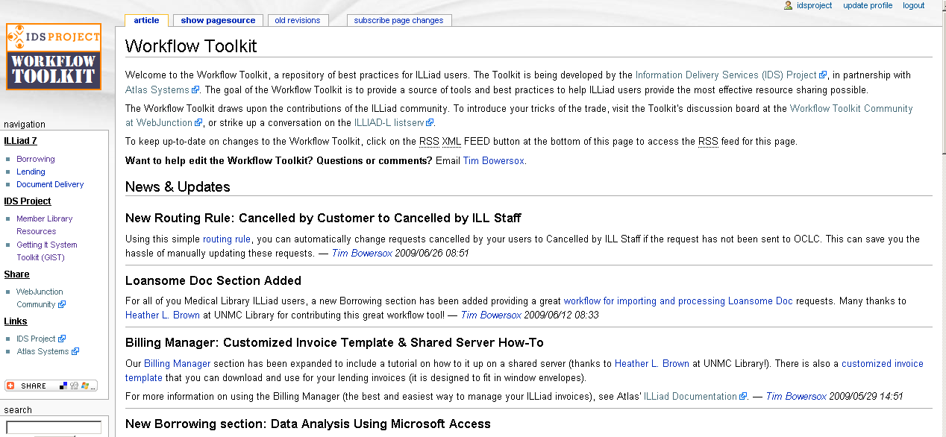
Best Practices
Mentor Program
Transaction Performance Analysis Module (TPAM)
Workflow Toolkit
Notes:
Today, we are going to discuss three of the best practices tools that the IDS Project libraries that are worth discussing and deliberating what role we have to the; Mentor program, TPAM, and Workflow Toolkit.

Slide 6
Best Practices: Mentor Program
Began in 2007; mentors assist libraries joining IDS Project and use of ILLiad.
Evolving charge…
Support optimal best practices in resource sharing among all IDS Project libraries.
Distributing continual improvements opportunities.
Notes:
How many here have found mentor relationships useful in their career? Origins & Explain evolving charge (Tim coordinates) – we are finding a need to help libraries that have been in the project awhile – the workflow toolkit and even the version changes of ILLiad bring new opportunities that aren’t adopted across the network.
It’s not like we don’t have enough to do, but the reality is – shared best practices in a library network is good for everyone’s business – plus, as someone who has seen many ILLiad libraries, visiting each site also teaches you about the variety of ways libraries and library staff do ILL.
I know when I do library consulting, one of my recommendations is that staff visit other libraries and take workflow tours.
Attendee suggested “Upgrade Day”

Slide 7
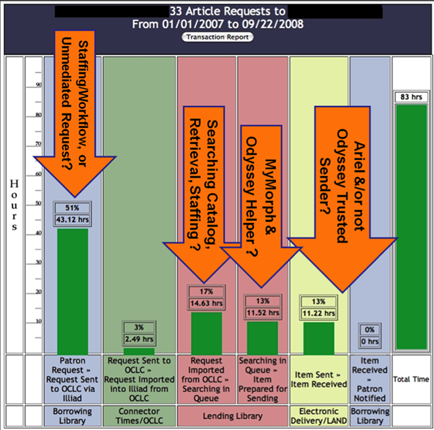
Best Practices: TPAM
TPAM Guide: http://idsproject.org/Tools/TPAM.aspx
Notes:
The TPAM is a useful tool CLICK because it helps libraries determine where processing time is spent at your library and can help diagnose problems that are patterns. This example shows several concerns with processing – elaborate

Slide 8
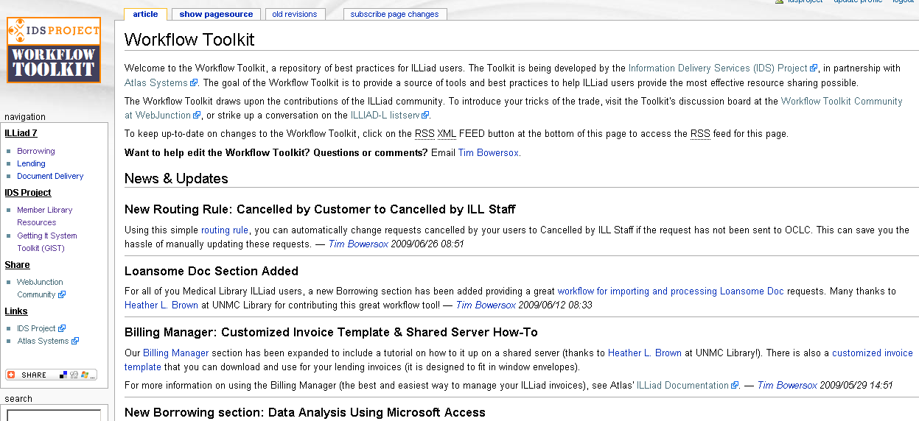
Best Practices: Workflow Toolkit
Over 100 ILLiad tips and workflow strategies shared in this popular wiki – used by libraries across the nation; growing by about one tip a week; authors from outside the project have joined the effort… but how good is it?
How many has your library adopted?
How useful are the tips?
Notes:
The Workflow Toolkit was released last year as a tool that was a way of sharing years of experience with ILLiad – you can call it a practical brain dump before this tie eliminated any common sense.
Thankfully, Tim Bowersox has taken it over, made it more useful and developing a national interest in working on it as a repository of best practices. While it has so many useful tips, libraries vary on implementing tips because of systems support, policy issues, & lack of commitment. I will cover some of the toolkit next, and highlighting 8 points in the checklist that has been handed out.

Slide 9
Best Practices: Top 8
Un-mediate processing
Direct Request
Custom Holdings
ALIAS
Odyssey Trusted Sender
Holdings Maintenance (required for automation):
OCLC Local Holdings Records , OCLC Reclamation, Knowledge Bases (Serials Solutions, SFX, etc.)
Continued on next page
Notes:
You can follow along with the checklist, but I will go into much more detail after I sort these into broad categories like un-mediate processing.
Two common principles worth mentioning to your staff – if you agree with it… Get your hands out of the process wherever automation is possible – unless you add significant value… and Don’t control everything for the one exceptions…
These common principles are not widely accepted because libraries are traditionally about control. Is that a surprise to anyone?

Slide 10
Best Practices: Top 8
Workflow Patterns
Utilize article conversion & Odyssey Helper
Change Inefficient Workflow Patterns
Knowledge sharing is the root of most answers
Actively participate in Best Practices Community by promoting…
Internal and external development and training
Communicate with vendors – problems & suggestions
We all have best & worst practices – so share the best, and be open to changing the worst
Network - Contact Tim Bowersox and invite mentors to visit, or visit a mentor library?
Notes:
The other two areas are general workflow patterns, and lastly, and quite honestly, probably the most important – knowledge sharing. Again, I am only cover 8 general best practice areas, but the Workflow Toolkit has over 100 tips.
Communicate with vendors… Don’t adopt problems – most can be solved. – report problems with vendors, etc. People change – get over it. Libraries have lots of books, and often carry a lot of baggage - this shouldn’t get in the way with our users, but it does – seek cooperative solutions might want to know exist.
Now for the details of the top 8…

Slide 11
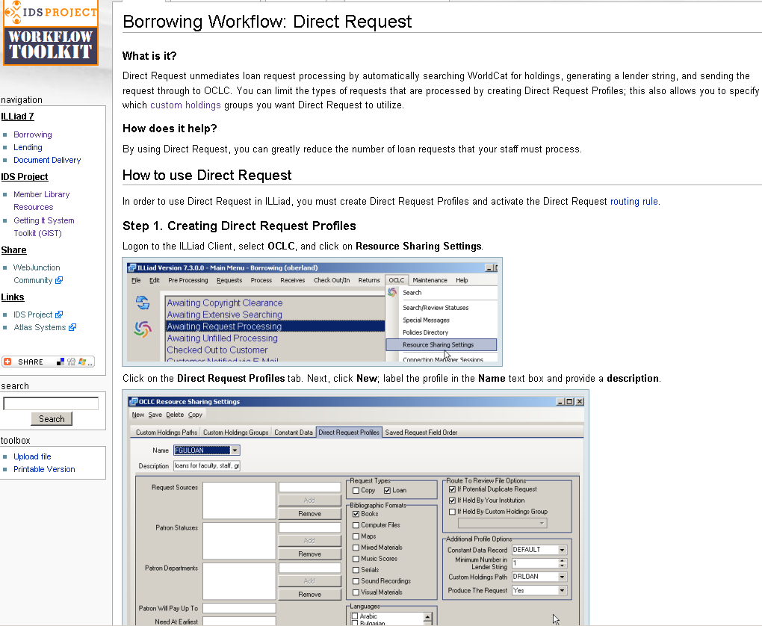
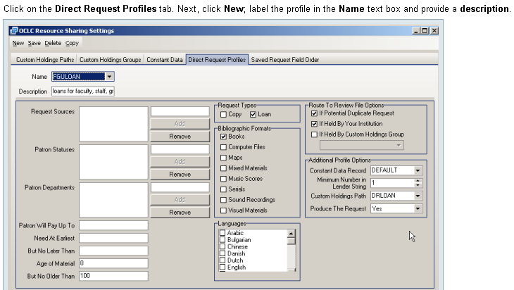
Best Practice #1: Direct Request
Bulk are automatically sent on to lending library
Staff focus on receives, and have time to for problem requests
Users places requests
Notes:
OCLC Direct Request automatically sends ILL requests to other libraries – it works if either the ISBN or OCLC# is present in the request, which is the bulk of requests received these days, thanks to OpenURL linked databases.
There are many ways to control this feature, by publication date, don’t let requests for items you own go (since 10-15% of ILL requests are for materials your library owns), and depending on how liberal you are with the settings, you can un-mediate over 50% of your book requests. Anyone not like that idea?
Would it surprise anyone to hear some libraries have this feature very restricted to the point of useless, and others intentionally don’t turn it on.
http://toolkit.idsproject.org/doku.php?id=borrowing:directrequest

Slide 12
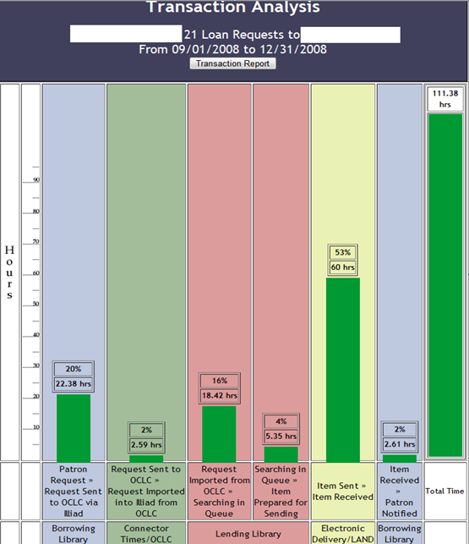
Direct Request Benefit
20 requests…
Average Time: 111.38 hours
Avg. Time from Patron Request to Sent to OCLC: 22.38 hours
Direct Request can cut 20% of the Turnaround time.
Common misconceptions with Direct Request:
- Users select the wrong record
+ OCLC sorts by most widely held.
- Direct Request makes errors
+ Yes, if holdings aren’t accurate or settings improperly administered.
- Staff make better decisions on lenders or availability
+ robust custom holdings, 1st lender fills 85% even without checking availability.
Notes:
So what are the benefits…
Almost 1 day spent before the request was sent off to the lending library.
Why would a library not optimize the use of Direct Request – common misconceptions and control.

Slide 13
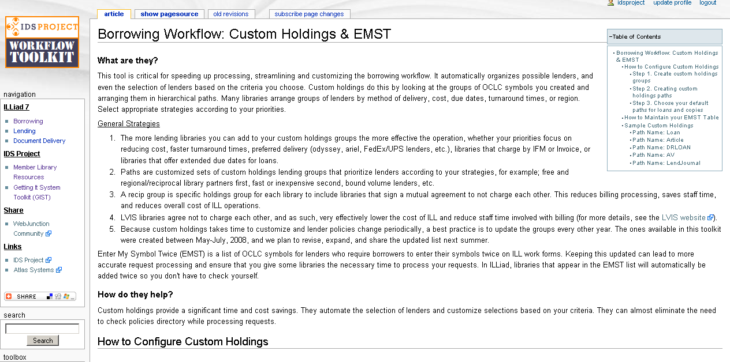
Best Practices #2: Custom Holdings
Benefits; lower cost, decrease turnaround time, decrease staff processing time, add other service qualities.
There are about 10,000 libraries use OCLC for ILL messaging.
Custom Holdings allows you to set lending priorities the way you want to, for an example of order…
1st IDS Project Libraries
2nd Regional Free Partners
3rd National Free Partners (East, Central, West groups)
4th Type of Delivery; Odyssey, Ariel, UPS, LAND, USPS, etc.
5th Cost (OCLC IFM)
6th Cost Invoice
Other Factors: Due Dates, Renewal, Slow but free, etc.
We created a set last year, and are about to release the new version:
http://toolkit.idsproject.org/doku.php?id=borrowing:customholdings
Notes:
In order for Direct Request to work well, and I would argue, to run ILL operations effectively and reduce cost, having a robust Custom Holdings is essential. This feature is simple a prioritized listing of all the library OCLC symbols in hierarchical groups. The more symbols, and higher degree of differentiation, the better performance for mediated and unmediated ILL requesting.
Often libraries spend little time on these, rarely update them, and that is why we added ours to the toolkit, updating them again this year, because why only revise them for us, share the benefits of our work is good practice.
http://toolkit.idsproject.org/doku.php?id=borrowing:customholdings

Slide 14
Best Practices #3: ALIAS
Estimation: July 2009
81 hours saved across the project by un-mediation.
Notes:
Explain…
I will combine my talk about Best Practice #3 ALIAS and #4 Odyssey Trusted Sender…
Dustin & Curtis – Atlas; OCLC: http://www.oclc.org/news/releases/200929.htm
The clunky mediated way – now automated – except for copyright clearance.
CLICK
Copyright clearance mediation should only be required if an article is published within 5 years, provided your library uses a copyright clearance bypass routing rule that is available at the toolkit – and from looking at the ALIAS turnaround time data, it appears the difference between libraries that have such a rule differ by about 15 hours.

Slide 15
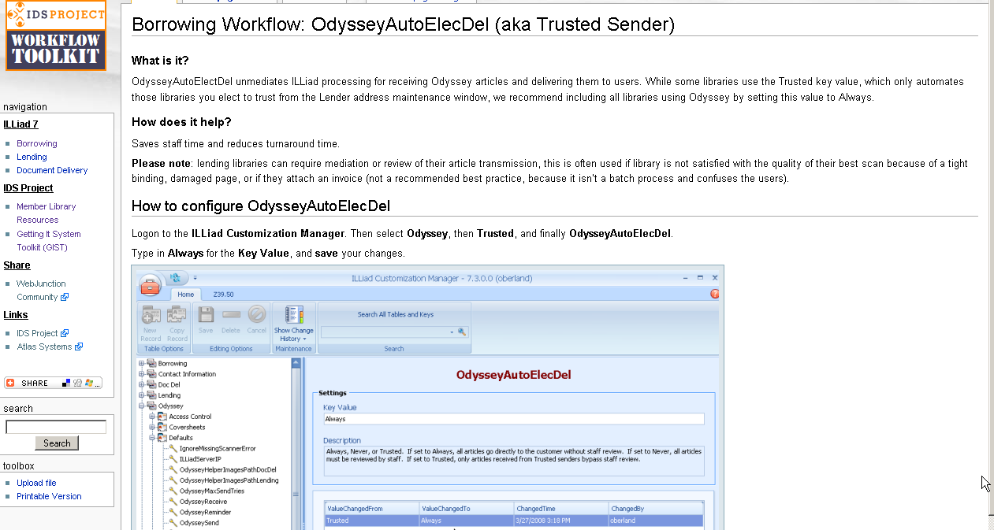
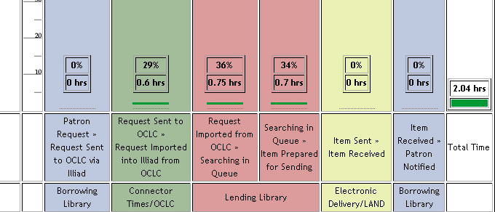
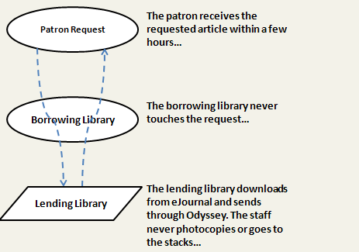
Best Practices #4: Odyssey Trusted Sender
How ALIAS & Odyssey work together…
Lending Library sends article via Odyssey
ILLiad receives & user notified to view
No mediation (unless lender checks – please review)
Benefits; decrease turnaround time, decrease staff processing time/cost.
Notes:
Explain what Odyssey Trusted Sender is and CLICK to see request.
ALIAS and Odyssey Trusted Sender work together to unmediate processes – and the results…
A really good set of articles filled within 2 hours. However, if you look at TPAM, most articles are filled within our benchmark of 48 hours.
Benefits to unmediated request processing seem obvious, but auto detection of your own holdings is a significant reduction in staff processing time considering that 1 out of every 10 requests is for materials held locally. Add to that, ALIAS, unlike any other systems, prioritizes electronic journal holdings before print journal holdings, and you have significant decrease in turnaround times.

Slide 16
Best Practices #5: Holdings Maintenance
Maintain OCLC Local Holdings is critical for the future of ALIAS – Integrated Fulfillment. OCLC LHR Info: http://www.oclc.org/batchprocessing/options/holdings/localdatarecords/
Maintain knowledge base in your link resolvers (Serials Solutions, SFX, etc.)
Also - add print (physical) serial holdings to your knowledge base – good for user & ALIAS: http://toolkit.idsproject.org/doku.php?id=wiki:ids_project
Benefits:
You, users, and other libraries know what you have.
Reduce staff time; cancelling requests, detecting local holdings, lower cost, etc.
Reduce turnaround times; more requests are handled automatically
Notes:
Explain the feedback that a library hasn’t maintained Serials Solutions holdings, so libraries are noticing that a lending library is cancelling many of their requests. Libraries adding electronic holdings in OCLC by hand, etc.

Slide 17
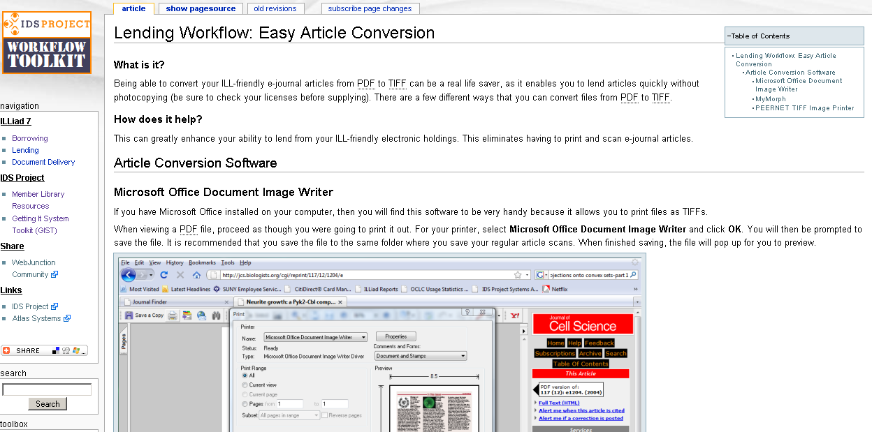
Best Practices #6: Article converters & Odyssey Helper
Open Article
Print out
Article
Convert
Article
Scan
Article
Send
Article
Notes:
Toolkit has a section on making lending of articles from electronic journals as easy as possible. We are all hoping that by ILLiad 8.1, importing PDFs would work, but until that happens, you have to either print the article and then scan the article – recycling the article; or simply convert the article using a few options outlined in the Toolkit.
What do you save besides staff time…

Slide 18
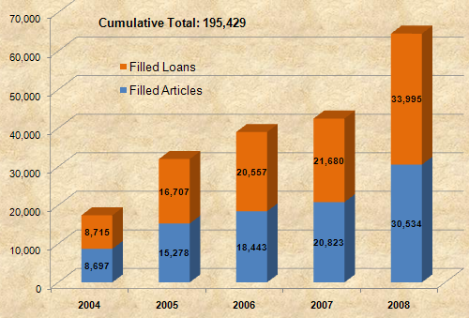
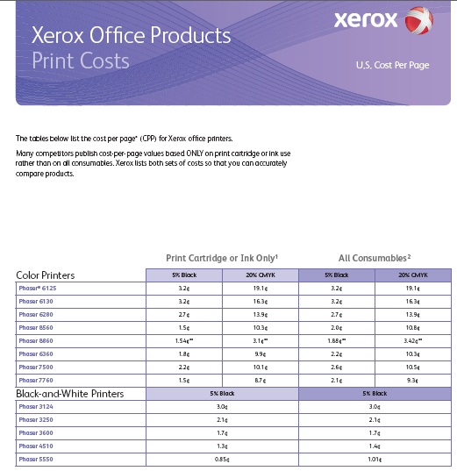
Best Practices #6: Article converters & Odyssey Helper
Notes:
Once estimate for printing charges roughly 1 to 3 cents per page, if we take that, multiply by the number of articles
While the cost may seem small, it is growing, and that really doesn’t add the cost of new fusers, staff time, and the need for multiple scanners. So, saving staff time, and carbon footprint and cost aside, article conversion just make sense. Similarly, batching the article processing delivery does too using Odyssey Helper, but as I mentioned, I am not going to go into all the workflow details – and if you are fascinated by process, I am certain your staff would be happy to have you take a tour.
Xerox Office products: http://www.office.xerox.com/latest/OPBFS-13.PDF

Slide 19
Best Practices #7: Change Inefficient Workflow Patterns
Anyone want to admit they have an inefficient workflow?
To name a few…
Paper files backing up ILLiad
Paper filing and retrieving instead of keeping it with the work
Writing or stamping on paperwork instead of ILLiad
Maintaining lists instead of incorporating them into ILLiad
Performing ILLiad functions just to move requests into a new status (not actually printing)
Clicking through pop-ups that can be turned off; ILLiad, Internet Explorer, etc.
Notes:
If there is a pattern you don’t like – fix it; recognize costly ones and eliminate it. Imagine printing out and filing a paper backup of every transaction in ILLiad – which is designed with backups, etc. in mind.
Does this seem like a duh list? PAUSE If so, great, then you probably have something to talk about with your staff, because these are common. Every library has probably at least one of these – from a recent consultation of a library that really knows how to use ILLiad, my 36 page report contained 102 recommendations and tips.
No process just because – shipping label printing, no paper files, no hand written notes, etc. Eliminate clunky extra steps – often, if there is a will there is a Workflow Toolkit way – or there will be (yes, you can ask for solutions)

Slide 20
Best Practices #8: Active Participant in Best Practices
Many ways to become active in best practices community
Internal discussion, workflow open houses, and training across library service units; cataloging, acquisitions, interlibrary loan, reference etc – MARC training.
External discussion and training with other libraries, workflow tours.
Actively report problems and enhancement suggestion to vendors. Contact: support@oclc.org
Actively share good ideas on the listservs and contribute to toolkit.
Invite mentors to visit or visit a mentor library – contact Tim Bowersox, IDS Project Mentor & Training Coordinator: bowersox@geneseo.edu
Other Suggestions?
How can you help? How to identify and share best practices?
Notes:
1. Explain MARC Training.
2. Explain workflow tours.
3. Many people aren’t asking for support because they often live through annoying problems, or they don’t think their enhancement will be implemented. Although OCLC and Atlas know my laundry list of suggestions is huge, they have implemented many.
4. Share ideas – too many of us think we don’t have anything to contribute, but I have visited over 50 ILLiad libraries and seen that in each workflow, yes, room for improvement, but also something cool and something I learned at each.
5. I must say that although we all feel like we know our business, the reality is that each shop can benefit from a discussion with other libraries, and the mentor program, although structured to provide support for new IDS Project libraries, are discussing how to work with all libraries that may want to review suggestions from the toolkit, or just exchange notes about workflow.
6. Are there any other suggestions for becoming active with best practices within the project?
7. That leads me to you – how can you all help? Role? (PAIR UP for 10 minutes to provide top 2 answers)

Slide 21
Best Practices
So where to next with our goal to “continually implement and objectively evaluate innovative resource sharing strategies, policies and procedures that will optimize mutual access to information resources…”
Notes:
What other best practices do you see on the horizon for libraries – and what is administration’s role with promoting best practices is an important goal for this successful project. While a unified community of trust and support seems like a cute saying, we are showing that by participating today, tomorrow and each day. Thank you for your participation.
Attendee feedback:
Create an IDS Admin listserv
Identify best practices with checklist is a great idea
Send out reminder to check TPAM – send out snapshots of TPAM analysis each end of semester.
Build in rewards.

Slide 22
Best Practices
Thank you
Questions, comments, suggestions?

Slide 23
Notes:
Best Practice Checklist – word document

